Slide 1

Finishing Strong: Wrapping Up Your 1st Semester in the Classroom

Slide 2
Hello!
I am Lydia Frass
I am here because I love to help people succeed.
You can find me at:
lfrass@mailbox.sc.edu

Slide 3
Agenda
USC Knowledge Check
Tips & Reminders
Reflection
Wrap-Up

Slide 4
Outcomes
Identify key wrap-up tasks
Reflect your first semester as an FTE faculty member
Prepare for a strong spring semester
Build momentum toward tenure & promotion, and long-term impact

Slide 5
1.
USC Knowledge Check
What have YOU learned?

Slide 6


What year was USC Founded?
1810
1801
1821
1811

Slide 7
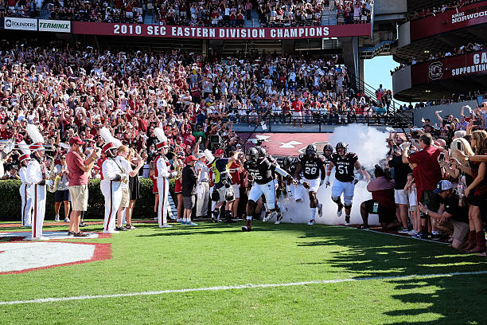
What music is played in the pregame entry of the football team?
Sandstorm
2001
The Fight Song
Sweet Caroline

Slide 8
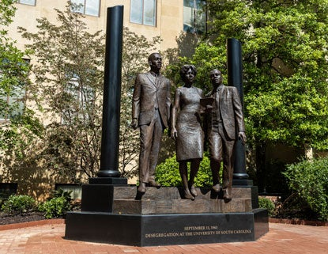
Which monument is in front of McKissick Museum?
War Memorial Garden
Desegregation Monument
Jonathan Maxcy Monument
Richard T. Greener Statue

Slide 9
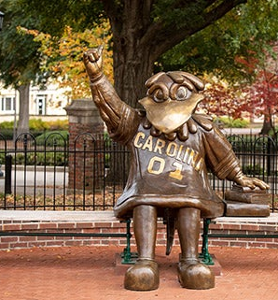
I love being Gamecock!
True
False

Slide 10
2.
Fall Wrap Up
Tips & Reminders

Slide 11
Academic Wrap-Up
Check the Registrar’s Final Exam Schedule
Dec 8-15, 2025; 2.5 hours max
Post grades in your Bb Gradebook
Submit Final Grades in my.sc.edu (Banner) – 72 hrs
Encourage students to complete course evals
Archive LMS content
Document incompletes & extensions
Notes:
Final Exam Schedule – in-person classes have specific days & times to administer exams in person. It set for two reasons – for students to be able to plan around their classes and (2) to ensure that there are rooms available. Online classes have some flexibility to administer it during this week.
You’ll find other details

Slide 12
Reflective Teaching Practices
Review course evaluations in December
Conduct personal teaching reflection
Gather informal feedback
Identify areas for pedagogical growth
Document teaching highlights for your annual review

Slide 13
Scholarship & Service
Review research progress & set writing goals
Identify conferences & publication deadlines
Evaluate service commitments & time balance
Update CV & digital portfolio

Slide 14
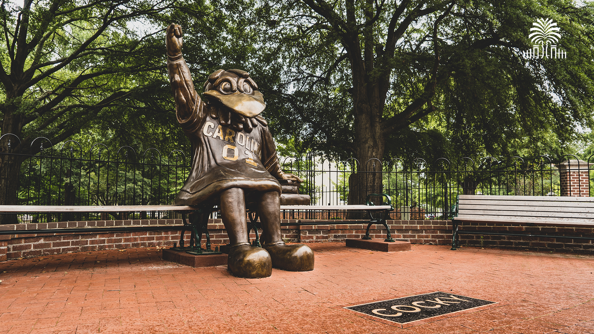
Even Cocky needs to sit & rest…

Slide 15
3.
Prepare for Spring
Starting Strong

Slide 16
Teaching Resources
Faculty support: dept., NFA Cohort, others
CTE’s Templates (Course shell, Syllabi, etc.)
CTE recording studio
Professional development opportunities
TCL: librarians, e-Reserves, ed films, book requests, OERs…
e-Learning Services: merge Bb sections, copy, etc.
Notes:
Faculty support contacts: dept., NFA cohort, others
CTE planning templates
E-learning services
Thomas Cooper Library
Grant support
Professional development opportunities – on campus, from your department & college, professional organizations…

Slide 17
Course Prep
Check Master Schedule for course formats & dates
Post syllabus in your Bb course & order textbooks
Prep Bb: Course copies & merging multiple sections
Check Bb Ally score and fix accessibility issues
Send “Welcome” Announcement with required book list – in December

Slide 18
What questions do you have about…
Finishing up this fall?
01
Prepping for spring?
02

Slide 19
4. Reflection
Lessons Learned

Slide 20

One Word Motivation

Slide 21

Challenges
This Photo by Unknown Author is licensed under CC BY

Slide 22
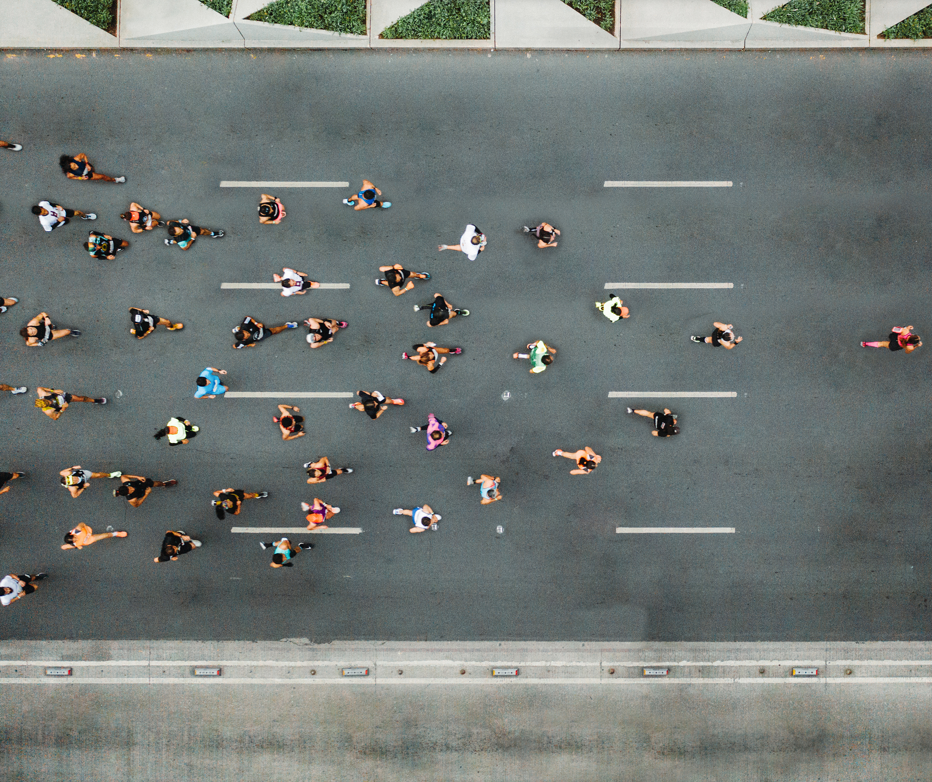





Success
This Photo by Unknown Author is licensed under CC BY-NC

Slide 23
You’ve planted seeds of impact – trust the process. Growth takes time, and every semester is a new opportunity. Remember, you’re not alone – lean into your community.

Slide 24
Any questions?
Lydia Frass, lfrass@mailbox.sc.edu

