Slide 1

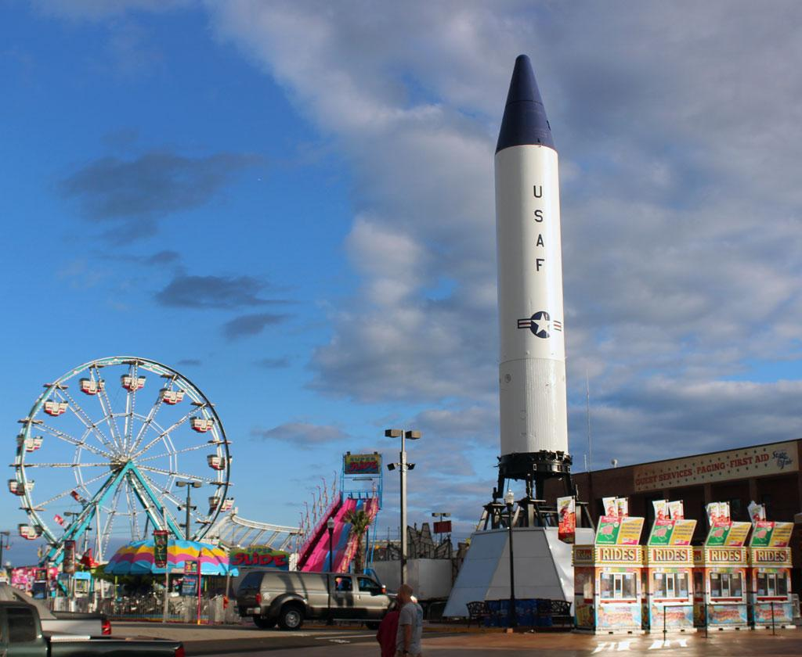


Midway Physics Day
Teacher Training
October 3, 2023

Slide 2
Outline for Training
Midway Day Description​
Practical Considerations​
  Preparing a lesson plan​
Executing Midway Day Successfully​
  Discussion​
Q and A

Slide 3
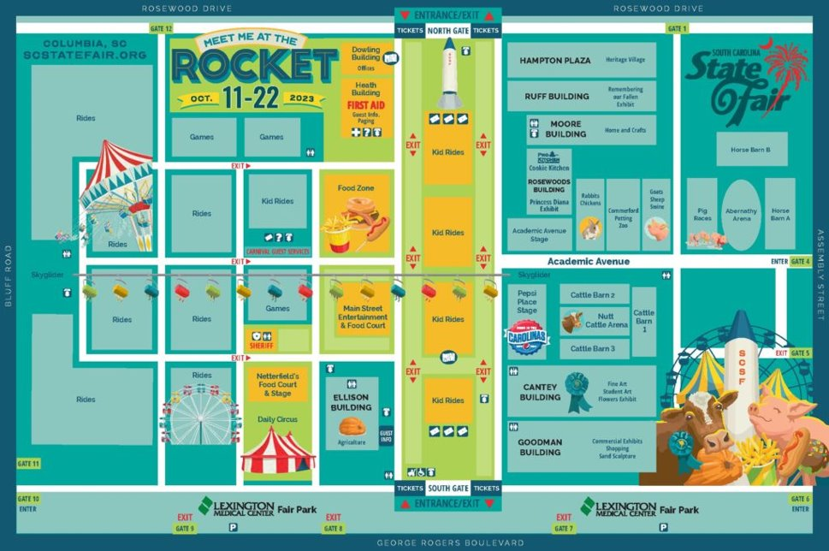
USC Physics Demonstrations Location
Academic Avenue Stage

Slide 4
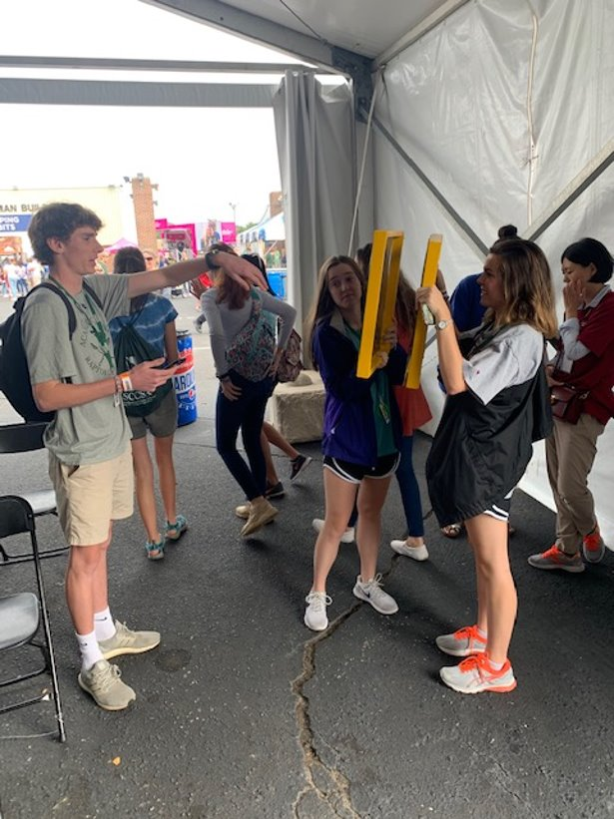
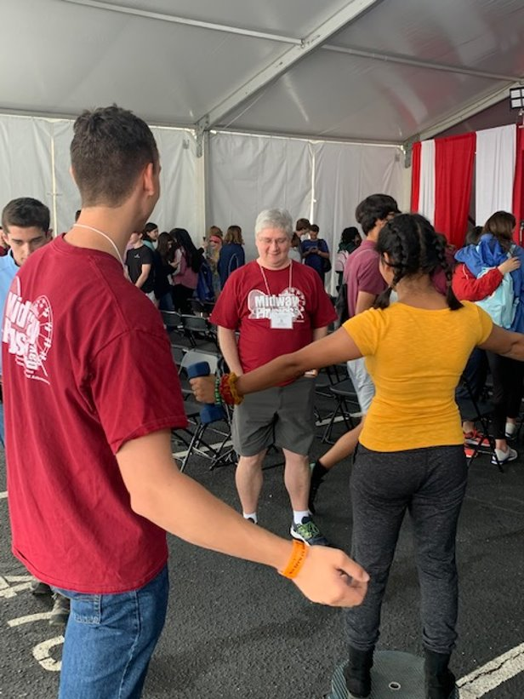
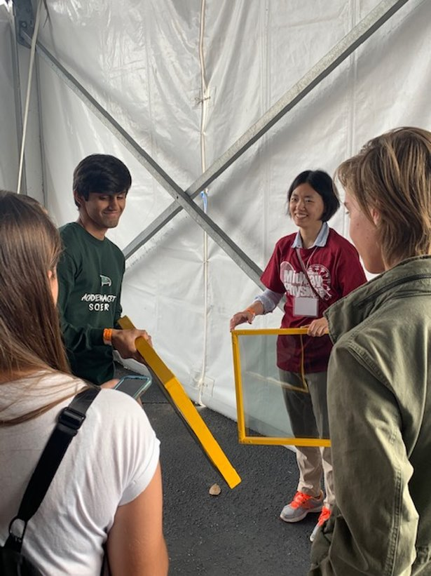
USC Physics Mentors
We work with students and teachers!

Slide 5
USC Midway Agenda
Timeline
9-11 am Prep for Event​
11-12pm Midway morning fun​
  **Check-in** and hands-on demonstrations​
12-2 pm Ride and ​Measure
  We will have our mentors at different rides to help
What is YOUR schedule? ​
Plan activities for the bus ride to and from the fair.​
Plan lunch time meeting – analysis, group coordination.​
Plan some free time for the students.

Slide 6
Demonstrations 11-noon
Plan activities related to the demonstrations.
Ex: Students must participate in and explain 2 demos.
Rotating platform
Vibrating springs
Singing bars
Bouncing Balls
Jumping Rings (Electromagnetic Forces)
Eddy Currents (Magnetic Braking)
Polaroid Sheets
Liquid Nitrogen Demonstrations
Optics Station Demos
Have students participate in demos while you check in.
Use the Academic Avenue Stage as “home-base”

Slide 7
Preparing a Lesson
Choose only a few rides to analyze (2 or 3)
  Many distractions at the fair
Don’t overreach
Plan a lesson in line with your course objectives and student abilities​
  Keep it simple
Prepare with your students before you arrive
  Have a practice session in class

Slide 8
Preparing a lesson
Make sure students can do everything before
  Bring calculators, pencils, printout, clipboard, protractors, etc.
  Download and be familiar with the measurement app, e.g. Arduino SJ
Budget time so students are successful​
  Arrive early and prepared​
  Use the bus ride for instruction/preparation​
  Use the lunch period to regroup and finish problem sets
  Recommend doing a pre-fair and a post-fair class session*
  * Only if it doesn’t interfere with regular instruction

Slide 9
Measurements can be detailed or estimated
Ferris Wheel
Measure the height of the ride with protractor or via air pressure.
Roller Coaster
Measure the period/frequency of rotation
Newton’s Laws (What forces are involved on the ride)
Circular Motion (Can measure ride radius and time period to get acceleration – compare with measurement)
Drop of Fear (Magnetic Force Braking)
Measure the free fall time. ​
Starship 2000
Measure the height of the ride.
Calculate the speed.​

Slide 10
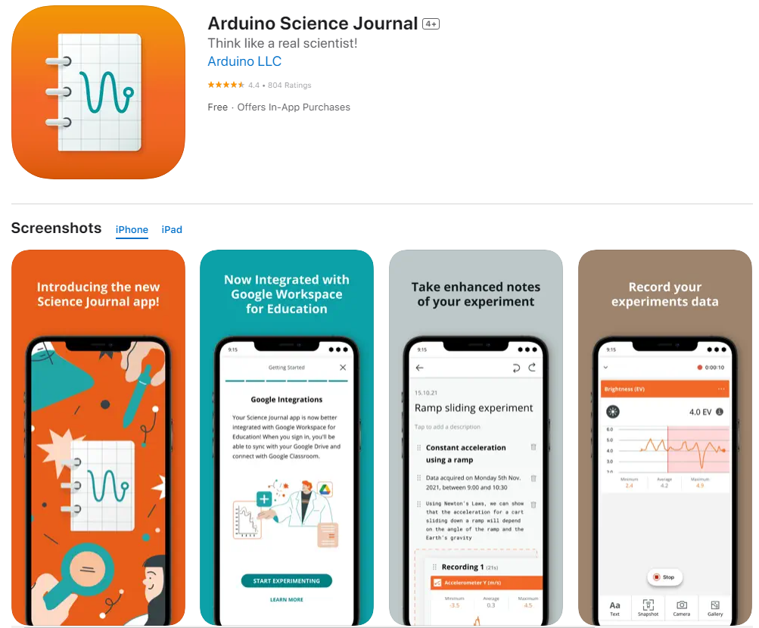
There’s an App for That
Use your smart phone’s sensors to take data at the fair!
https://www.arduino.cc/education/science-journal

Slide 11
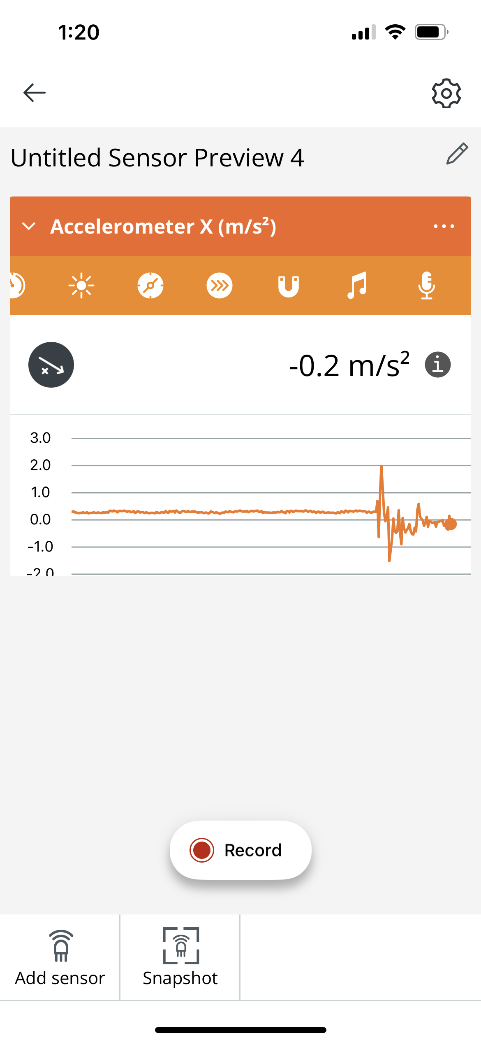
There’s an App for That
Use your smart phone’s sensors to take data at the fair!
https://www.arduino.cc/education/science-journal
An array of internal sensors to choose from.
When in doubt, click this. It will tell you exactly what is being measured and what sensor is used.
Allows you to measure multiple quantities at the same time
Record will save the numerical data
Only records the instantaneous value

Slide 12
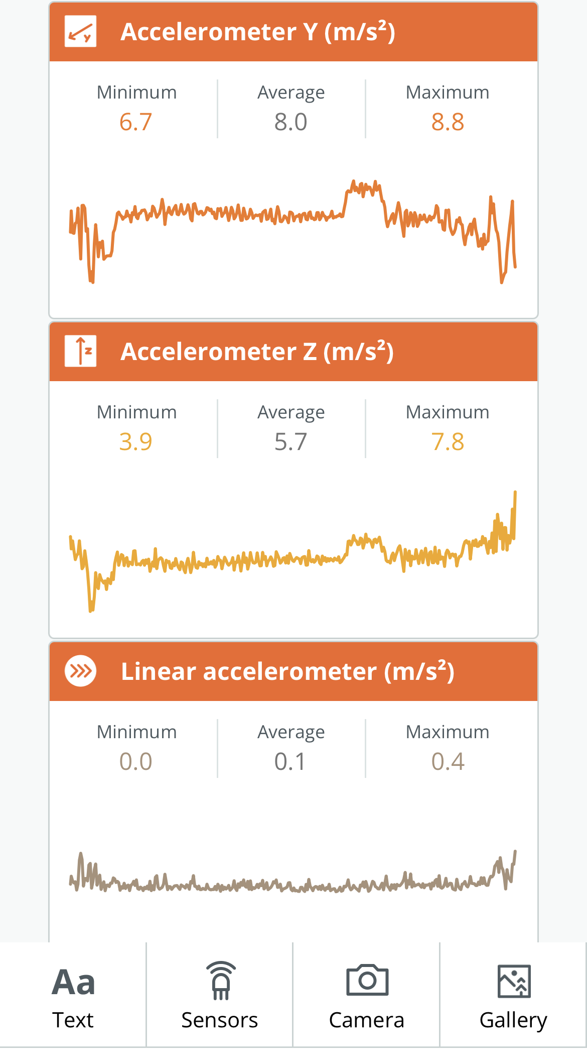
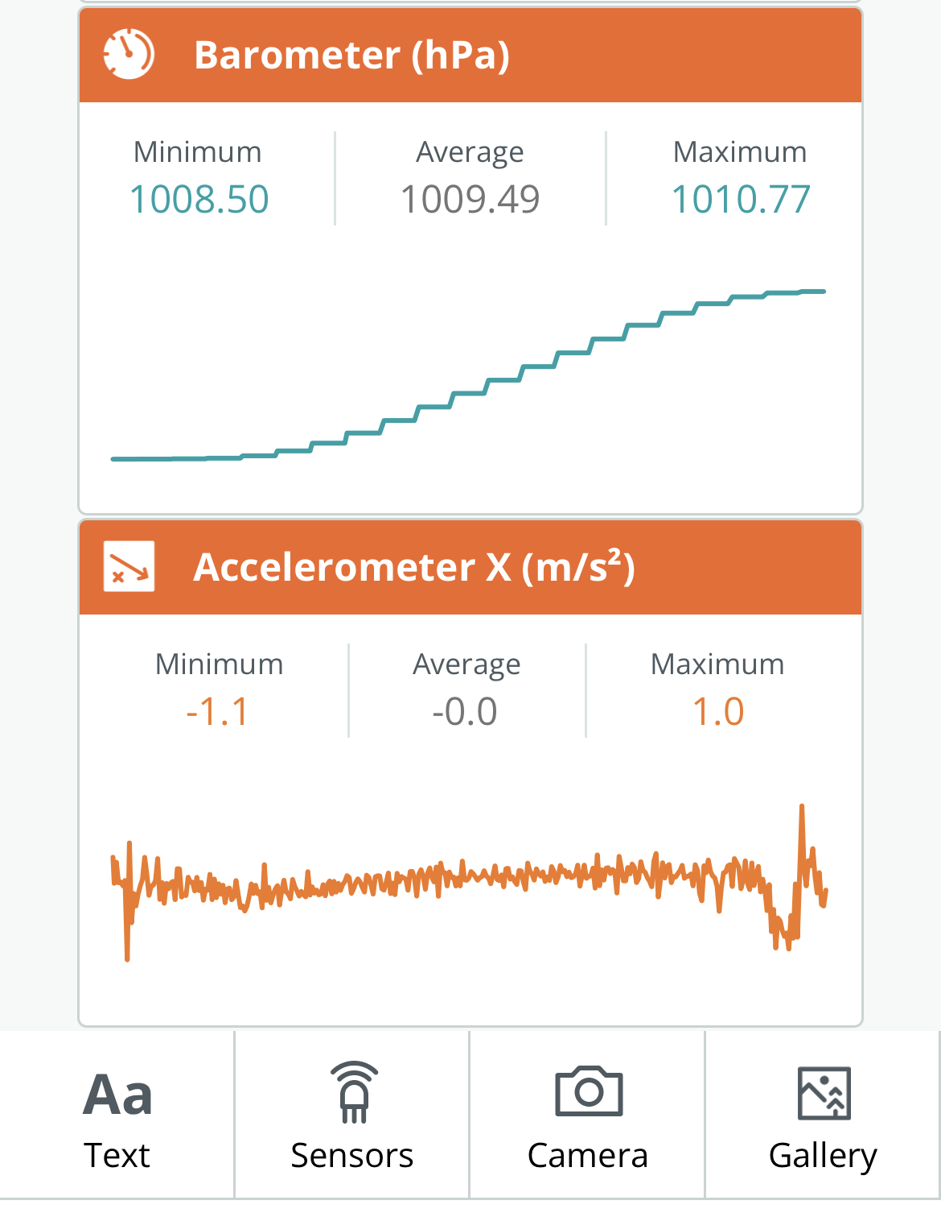
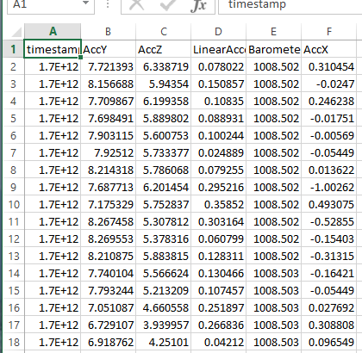
There’s an App for That
Ex. Recording of Yanwen’s elevator ride (From 5th floor to 1st floor in Jones) with 5 sensors selected
Data can be easily exported to a single Excel spreadsheet

Slide 13
SC Educational Standards
Standard H.P.1: The student will use the science and engineering practices, including the processes and skills of scientific inquiry, to develop understandings of science content.
Standard H.P.2: The student will demonstrate an understanding of how the interactions among objects and their subsequent motion can be explained and predicted using the concept of forces.
Standard H.P.3: The student will demonstrate an understanding of how the interactions among objects can be explained and predicted using the concept of the conservation of energy.

Slide 14
EX.
Roller Coaster Activity
- Why is the second hill shorter than the first?
- Assuming no friction how much potential energy was stored on the first climb?
- Determine the gravitational potential energy on the second hill.
- Label the sections on your sketch that represent the greatest kinetic energy.
- Determine the average and the maximum velocity of the ride.
- Where does the maximum and minimum acceleration occur?
- Compare the calculated acceleration with the acceleration you measured with an accelerometer

Slide 15
Printed Resources
Teachers Guide
Sample worksheets
​Midway Physics Day Website
State Standards

Slide 16
Final Thoughts
Midway Physics Day is a fun and effective way to motivate your class about science.
What else can we do to help improve this experience?
Questions??

Slide 17


Thanks!
See you in 2 weeks!
Yanwen Wu and Nancy Kesar
Student Services Coordinator
803-777-8105

