Slide 1
“When Someone sees me, I am nothing of the norm”: examining the discursive role power plays in shaping lgbtq+ health information practices
Vanessa L. Kitzie
@vkitzie
Travis L. Wagner
@trlwagner
A. Nick Vera
@nickvera22

Slide 2

Introduction: LGBTQ+ Health information worlds
Equitable access to health information is a preeminent goal of society
  Yet, equity remains contingent on multiple sociocultural identities
  Lesbian, gay, bisexual, transgender, and queer (LGBTQ+) populations face particular relationships to normative power in healthcare access (HealthyPeople, 2019)
    These Challenges are Heightened in the American South (Matthews & Lee, 2014; Williams Institute, 2019)
  These discursive relationships inform how LGBTQ+ leaders and their communities create, seek, share, and use, health information

Slide 3
Research questions
RQ1: How can the health practices of SC LGBTQIA+ communities be described?
RQ2: How does discursive power shape these practices?

Slide 4
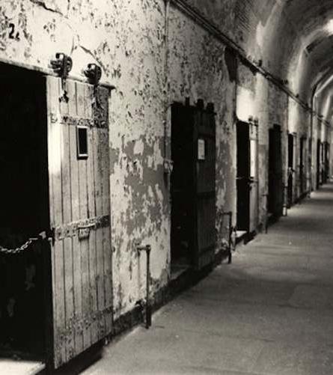
Literature Review: Discursive power
Discourses consist of relationships between people, texts, ideas, and institutions.
  Individuals possess power through demarcating an “other” as lesser
Historically LGBTQIA+ populations were subject to correction and hospitalization (Foucault, 1978)
Normal sexuality presumed to be heterosexual (ie. heteronormativity) and the normal gender presumed to be cisgender (ie. cisnormativity)
  Impacts law (Spade, 2015), public policy (Davis, 2017), and librarianship (Adler, 2017)
These presumptions shape how LGBTQIA+ persons create, seek, share, and use health information

Slide 5

Literature Review: Information Practices
Information practices are socially constructed (Savolainen, 2008)
LGBTQ+ information practices challenge dominant ideologies (Floegel & Costello, 2019; Kitzie, Wagner, & Vera, 2020)
Can discursive power seep into LGBTQ+ community dynamics and information practices?

Slide 6
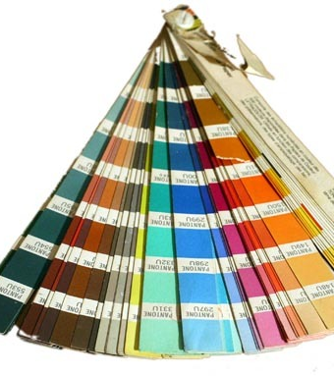
Methods
30 SC LGBTQ+ community leaders ages 13+
IRB waiver of parent/guardian consent
Sampling: Purposive, Snowball, Theoretical
Semi-structured interviews
Information worlds mapping (IWM) (Greyson, 2013)
In-person interviews (with exception of 2 telephone)
Interviews audio-recorded & transcribed
Open qualitative coding (Strauss & Corbin, 1994)
  IWM made use of situational analysis via memos (Clarke, 2005)
  Locating memos, big picture memos, specification memos (Greyson et al., 2019)
Validity: Team coding meetings, member-checking, multiple data collection methods
Pseudonyms used

Slide 7
Findings

Slide 8
Participant Demographics
Table 3. Education
Education | n | %
Some college credit | 7 | 24%
Master’s degree | 6 | 20%
Associate degree | 5 | 17%
Bachelor’s degree | 5 | 17%
In high school | 2 | 7%
In middle school | 2 | 7%
High school diploma | 1 | 4%
Doctoral degree | 1 | 4%
GED or alt. credential | 1 | 4%
Table 1. Age Range
Age | n | %
18-25 | 11 | 37%
35-54 | 7 | 24%
55-64 | 4 | 14%
13-17 | 4 | 14%
26-34 | 3 | 10%
65+ | 1 | 4%
Table 2. Race & Ethnicity
Race & Ethnicity | n | %
White | 18 | 60%
Black | 7 | 24%
Black, White | 2 | 7%
Black, Afro-Caribbean | 1 | 4%
Aboriginal, Arab/West Asian, Black, White | 1 | 4%
Black, White, Egyptian | 1 | 4%

Slide 9
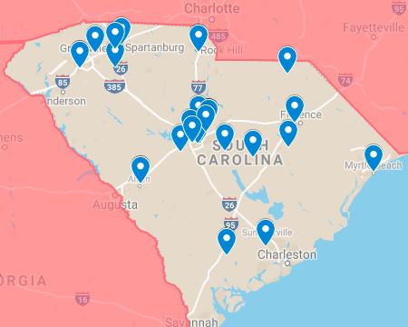
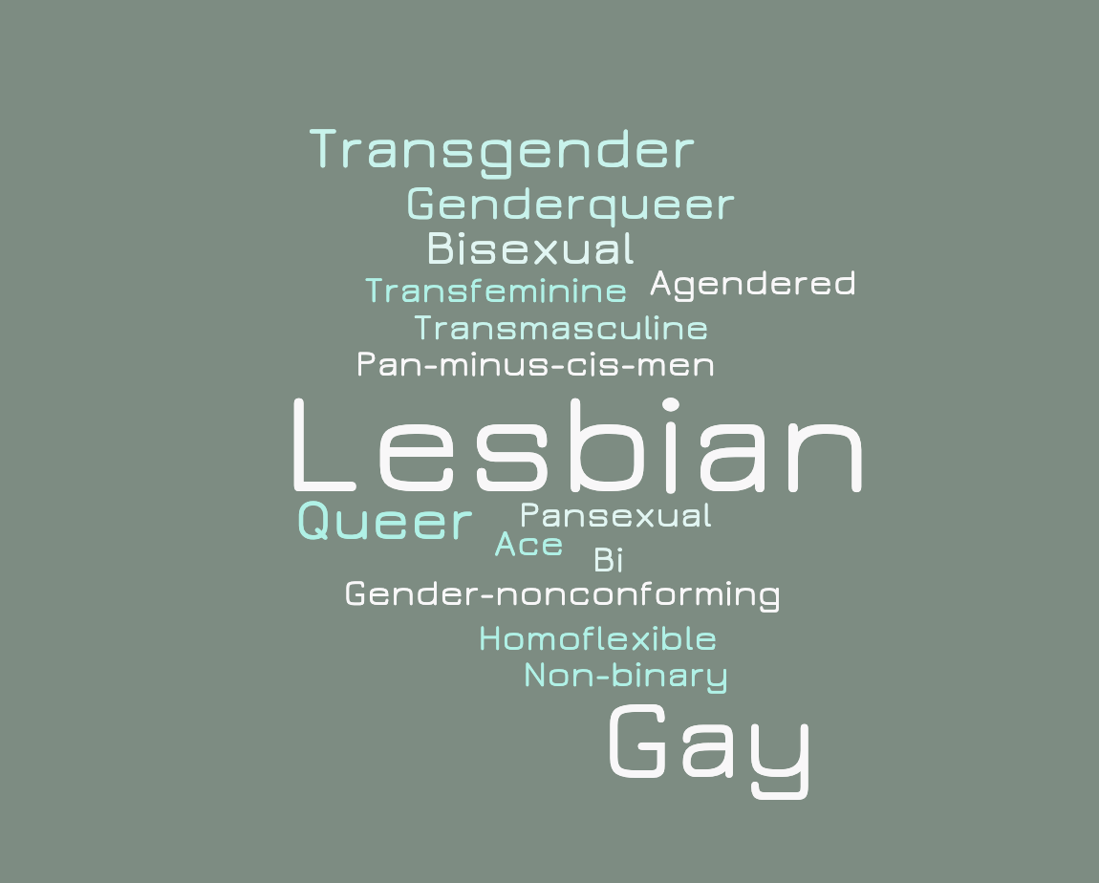
Participant Demographics

Slide 10
Condensing LGBTQ+ people into monoliths
Discourses that conflate the experiences of some community members with those of all LGBTQ+ individuals
Privileges cisgender, gay, white men
Impacts presumed access to health care resources

Slide 11
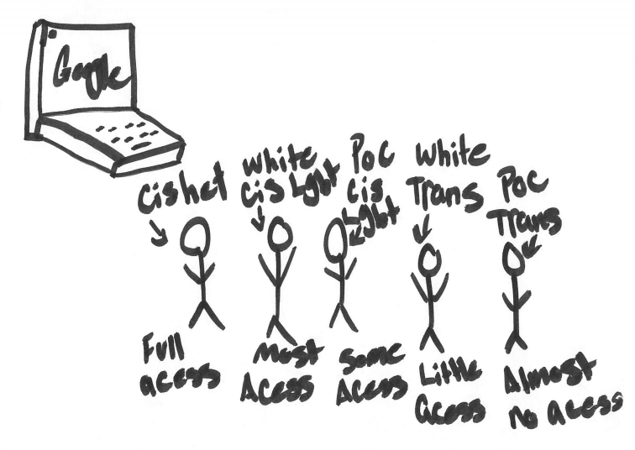
Vada’s map

Slide 12
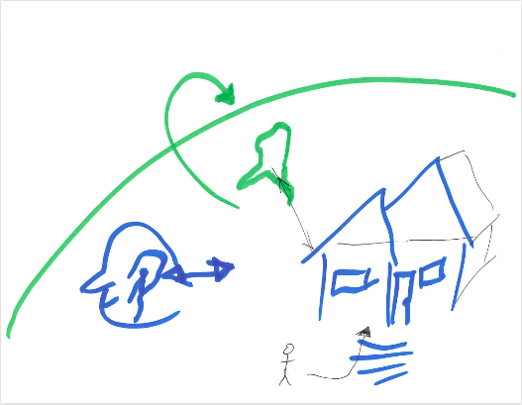
Charles’ Map

Slide 13
Establishing community’s normative role in information practices
Community defines normative information practices
  In response to information that might harm individual members
Practices often mirror established information practices (ie. word of mouth and mediation)

Slide 14
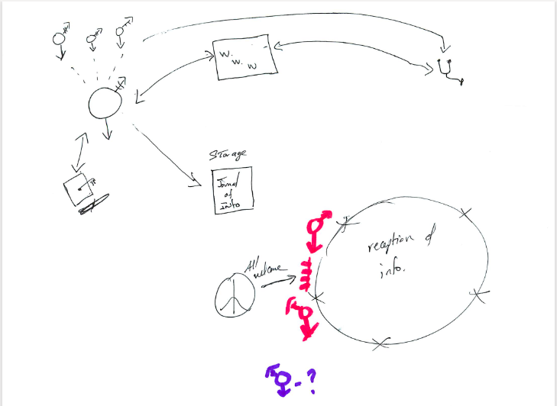
Tony’s map

Slide 15
Charles’ Map

Slide 16
Applying metronormativity discourses to information sources
Metronormativity describes the constructed binary of LGBTQ+ experiences into urban (good)/rural (bad).
  Presumes LGBTQ+ person cannot live a meaningful life unless they reside in a metropolitan area (Halberstam, 2005)
  Metronormativity as identifying national LGBTQ+ advocacy organizations as ideal information source

Slide 17
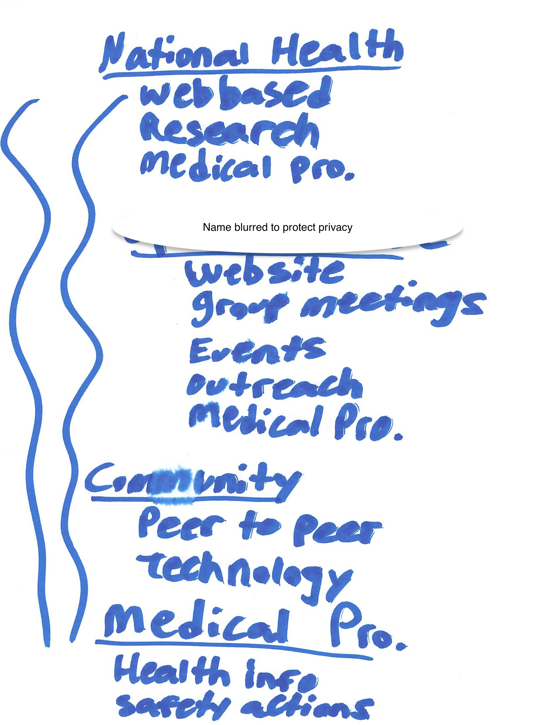
Tony Solano’s Map

Slide 18
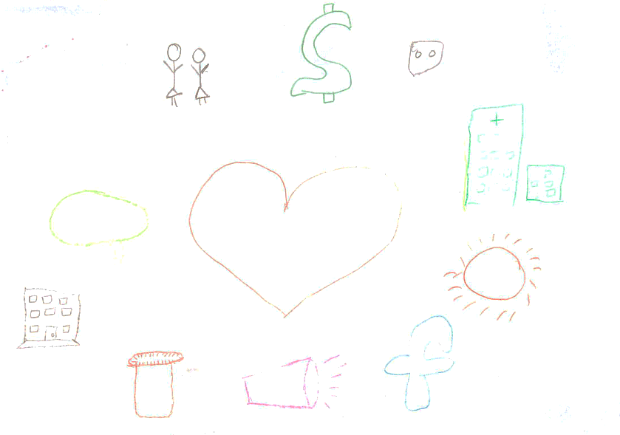
Pat’s Map

Slide 19
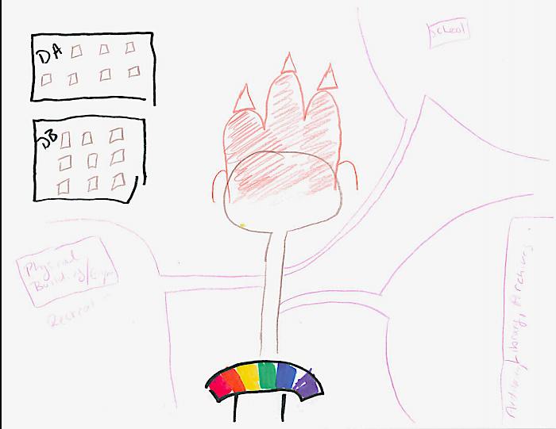
Discussion
Jordan’s Map
Themes
Leaders and gatekeepers construct imagined LGBTQ+ community and normative presumptions followed
Criticism of discursive power is not criticism of “goodness” of participants
For some participants, such as Jordan, resisting discursive power became a site of imagined potentialities within their map

Slide 20

Conclusion
Leaders can provide more equitable flow of information in their communities through critical consideration of existing arrangements (people, knowledges, practices, resources, etc.)
Continued uplifting of alternative resources and imagined paths for collective resistance

Slide 21
Thank you!
Questions?
For more project info:
http://bit.ly/hiplgbtq

Slide 22
References
Adler, M. (2017), Cruising the library: Perversities in the organization of knowledge. Fordham University Press, New York, NY.
Charest, M., Kleinplatz, P. J., & Lund, J. I. (2016). Sexual health information disparities between heterosexual and LGBTQ+ young adults: Implications for sexual health. The Canadian Journal of Human Sexuality, 25(2), 74-85.
Clarke A. (2005) Situational analysis: grounded theory after the postmodern turn. Thousand Oaks, CA: SAGE.
Crenshaw, K. (1991).Mapping the margins: Intersectionality, identity politics, and violence against women of color. Stanford Law Review, 43, 1241-1299.
Davis, H.F. (2017), Beyond trans: Does gender matter? New York University Press, New York, NY.
Floegel, D., & Costello, K. L. (2019). Entertainment media and the information practices of queer individuals. Library & Information Science Research, 41(1), 31-38.
Foucault, M. (1978). The history of sexuality. Volume 1: An introduction. New York, NY: Pantheon Books.
Greyson, D. (2013). Information world mapping: A participatory, visual, elicitation activity for information practice interviews. Proceedings of the American Society for Information Science and Technology, 50(1), 1-4.
Greyson, D., O’Brien, H., & Shoveller, J. (2017). Information world mapping: A participatory arts-based elicitation method for information behavior interviews. Library and Information Science Research, 39(2), 149–157.
Greyson, D., O’Brien, H., & Shankar, S. (2019). Visual analysis of information world maps: An exploration of four methods. Journal of Information Science, 1–17.
Halberstam, J. (2005). In a queer time and place: Transgender bodies, subcultural lives. New York, NY: New York University Press.
Hillary, G. A. (1995) Definitions of community: Areas of agreement. Rural Sociology, 20, 111-123.
Kitzie, V., Wagner, T.L., & Vera, N. (2020). “In the beginning, it was little whispers…now, we’re almost a roar”: Conceptualizing a model for community and self in LGBTQ+ health information practices. In A. Sundqvist, G. Berget, J. NolinKjell, & I. Skjerdingstad (Eds.), Sustainable digital communities: 15th International Conference, iConference 2020, Boras, Sweden, March 23–26, 2020, Proceedings (pp. 15–31). Switzerland, AG: Springer, Cham.
Matthews, D. D., & Lee, J. G. (2014). A profile of North Carolina lesbian, gay, and bisexual health disparities, 2011. American journal of public health, 104(6), e98-e105.

Slide 23
References
Ma, J., Stahl, L., & Knotts, E. (2018). Emerging roles of health information professionals for library and information science curriculum development: a scoping review. Journal of the Medical Library Association: JMLA, 106(4), 432.
Morgan, A. & Ziglio, E. (2006) Foreword. In: Capability and resilience: beating the odds. Department of Epidemiology and Public Health, University College London, London.
Morris, M., & Hawkins, B. (2016). Towards a new specialization in health librarianship: LGBTQ health. Journal of the Canadian Health Libraries Association, 37(1), 20-23.
Olsson, M. (2005). Beyond ‘needy’ individuals: conceptualizing information behavior. Proceedings of the American Society for Information Science and Technology, 42(1).
Pollack, H. (2008). Moral, prudential, and political arguments about harm reduction. Contemporary Drug Problems, 35, 211 - 239.
Raj, S., Sharma, V. L., Singh, A., & Goel, S. (2015). The health information seeking behaviour and needs of community health workers in Chandigarh in Northern India. Health Information & Libraries Journal, 32(2), 143-149
Romanelli, M., & Hudson, K. D. (2017). Individual and systemic barriers to health care: Perspectives of lesbian, gay, bisexual, and transgender adults. American Journal of Orthopsychiatry, 87(6), 714.
Ross, C. (2012). Imagined communities: initiatives around LGBTQ aging in Italy. Modern Italy, 17(4), 449-464.
Saldaña, J. (2015). The coding manual for qualitative researchers. SAGE, Thousand Oaks, CA
Savolainen, R. (2008). Everyday information practices: A social phenomenological perspective. Lanham, MD: The Scarecrow Press, Inc.
Spade, D. (2015), Normal life: Administrative violence, critical trans politics, and the limits of law. Duke University Press, Durham.
Williams Institute (2018). LGBT people in South Carolina. Retrieved from: https://williamsinstitute.law.ucla.edu/wp-content/uploads/South-Carolina-fact-sheet.pdf

